Slide 1

… a web server for precise genome-based prokaryotic identification
… a fungal version to come soon, and a plant virus version to come later
… metagenomic sequences cannot be used unless the pathogen is highly abundant, but …

Slide 2
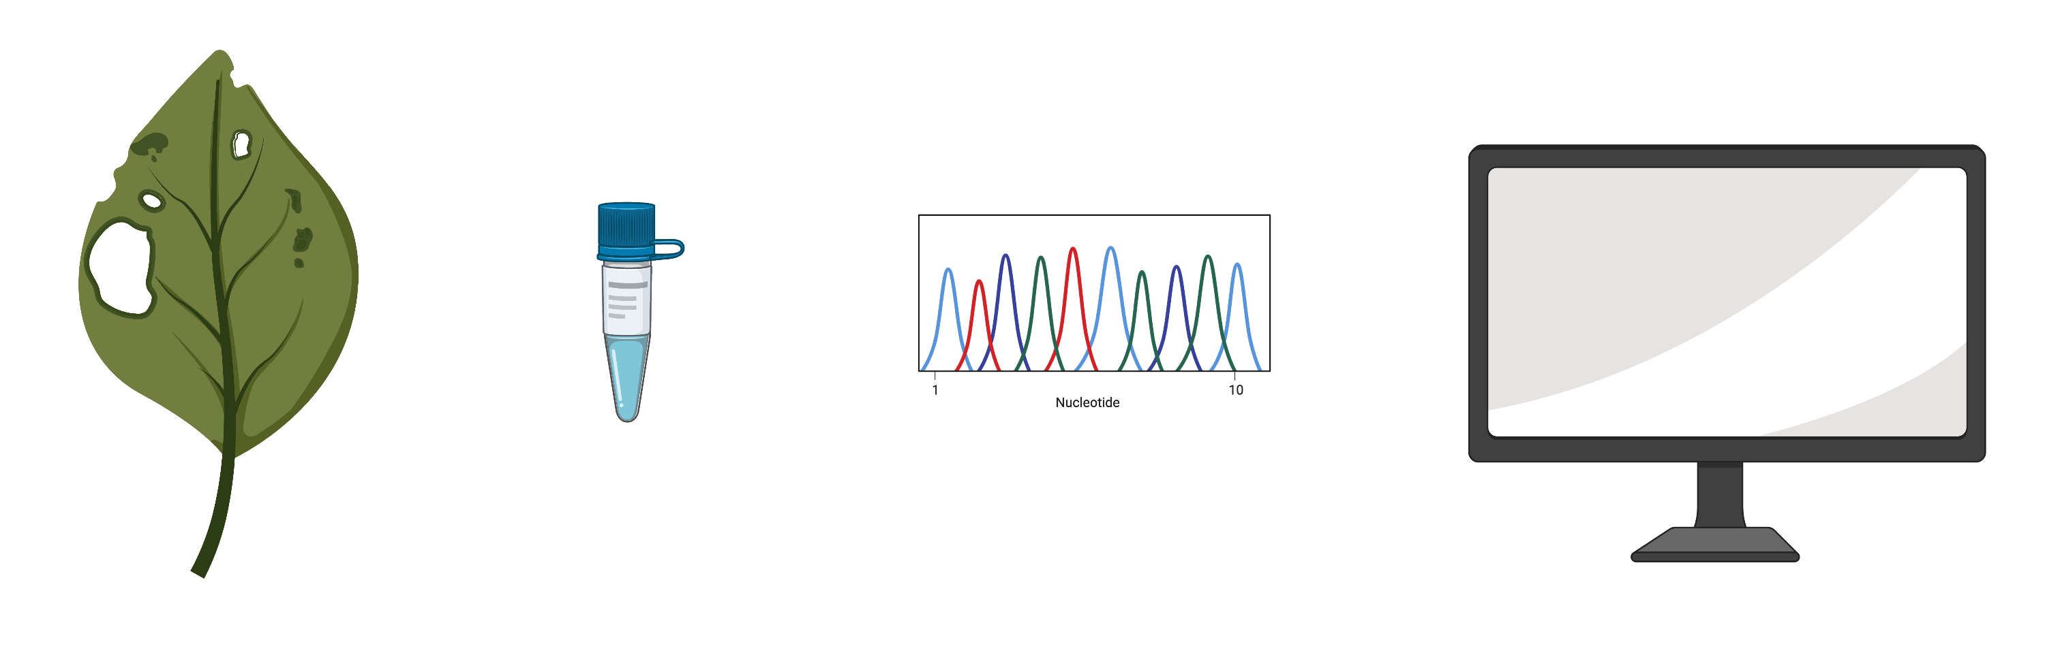
Science Fiction of Plant pathogen identification
The pathogen is:
Extract + sequence + computer programs + databases + AI + network
Fast: hours
Precise identification + characterization + outbreak investigation
for any and all pathogens
made with biorender.com
Notes:
Viruses, bacteria, fungi, oomycetes, established, emerging; characterization (phenotype prediction: host range, antibiotic/fungicide resistance …)

Slide 3
Pathogen Identification
Usually a two-step process:
Taxonomic identification to the genus or species rank
Strain typing to identify the precise strain within the species, source attribution, outbreak detection and investigation, and more …

Slide 4
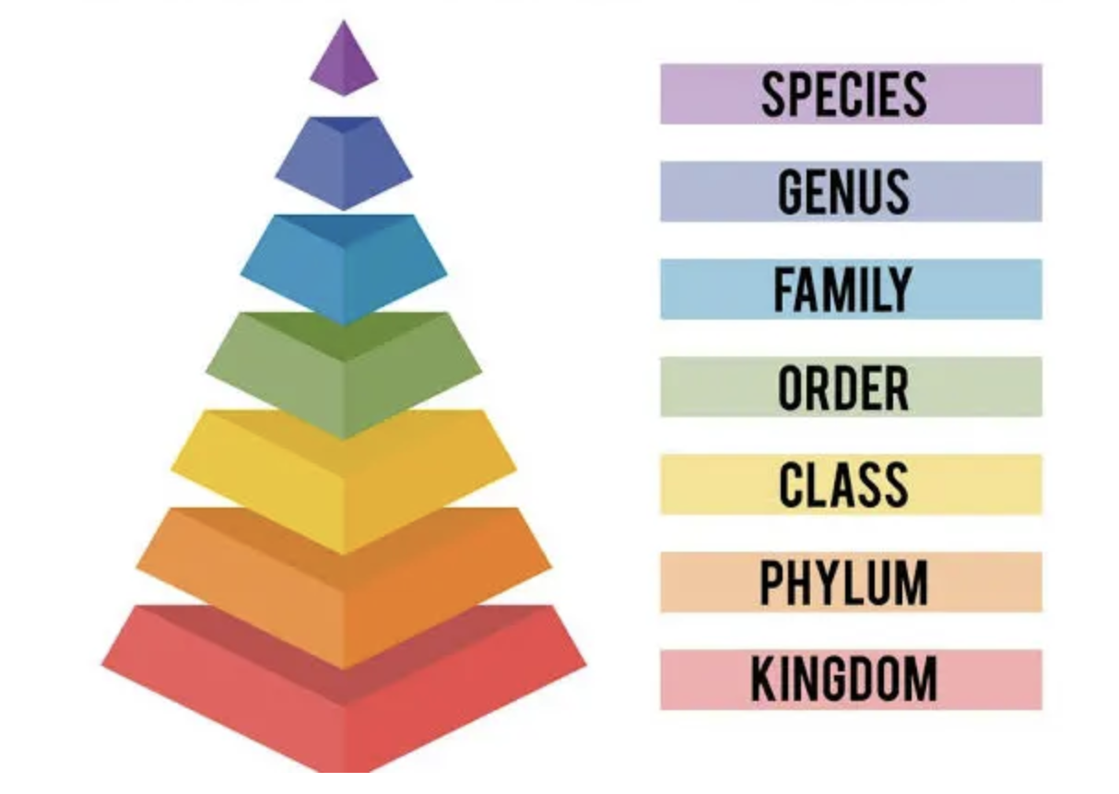
Taxonomy: identify to the genus or species rank

Slide 5
Genome-based taxonomic identification (focus on prokaryotes)

Slide 6
Average Nucleotide Identity (ANI)
How different two genomes are from each other
Species delineation: 95%
Average amino acid identity (AAI) for higher taxonomic ranks
Genus 1 species 2
Genus 1 species 1
>95% ANI and share at least one diagnostic phenotype
type strain 2
<95% ANI
and different
in at least one
diagnostic phenotype
type strain 1

Slide 7
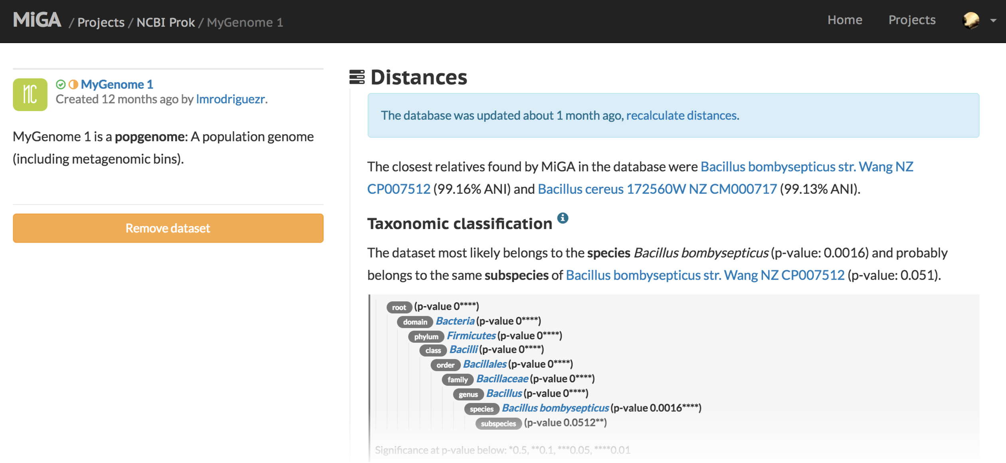

Rank-based taxonomy using genomics
Rodríguez-Rojas et al. 2018

Slide 8
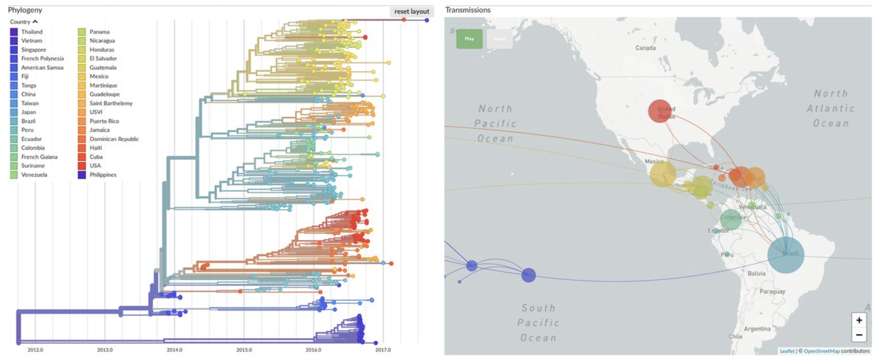
Strain-typing using genomics
Neher & Bedford 2018
Nextstrain, GenomeTrakr Network … needs to be set up new for each species

Slide 9
Bridging taxonomy and strain typing
Could we extend the use of ANI from the genus and species rank to the strain level … and detect outbreaks (not investigate)?
Yes, using the Life Identification Number (LIN) approach

Slide 10
Taxonomic Rank-Independent Taxonomy (simplified example)
genus
strain
ANI
LINs
* Type strain
Vinatzer et al 2017
ANI is informative from the genus rank and almost reaches strain-level resolution.

Slide 11
Taxonomic Rank-Independent Taxonomy (simplified example)
genus
strain
ANI
LINs
* Type strain
Vinatzer et al 2017
ANI is informative from the genus rank and almost reaches strain-level resolution.

Slide 12
Taxonomic Rank-Independent Taxonomy (simplified example)
genus
strain
ANI
LINs
* Type strain
Vinatzer et al 2017
ANI is informative from the genus rank and almost reaches strain-level resolution.

Slide 13
Real example: Ralstonia solanacearum species complex bacterial wilt species, phylotypes, sequevars …

Slide 14
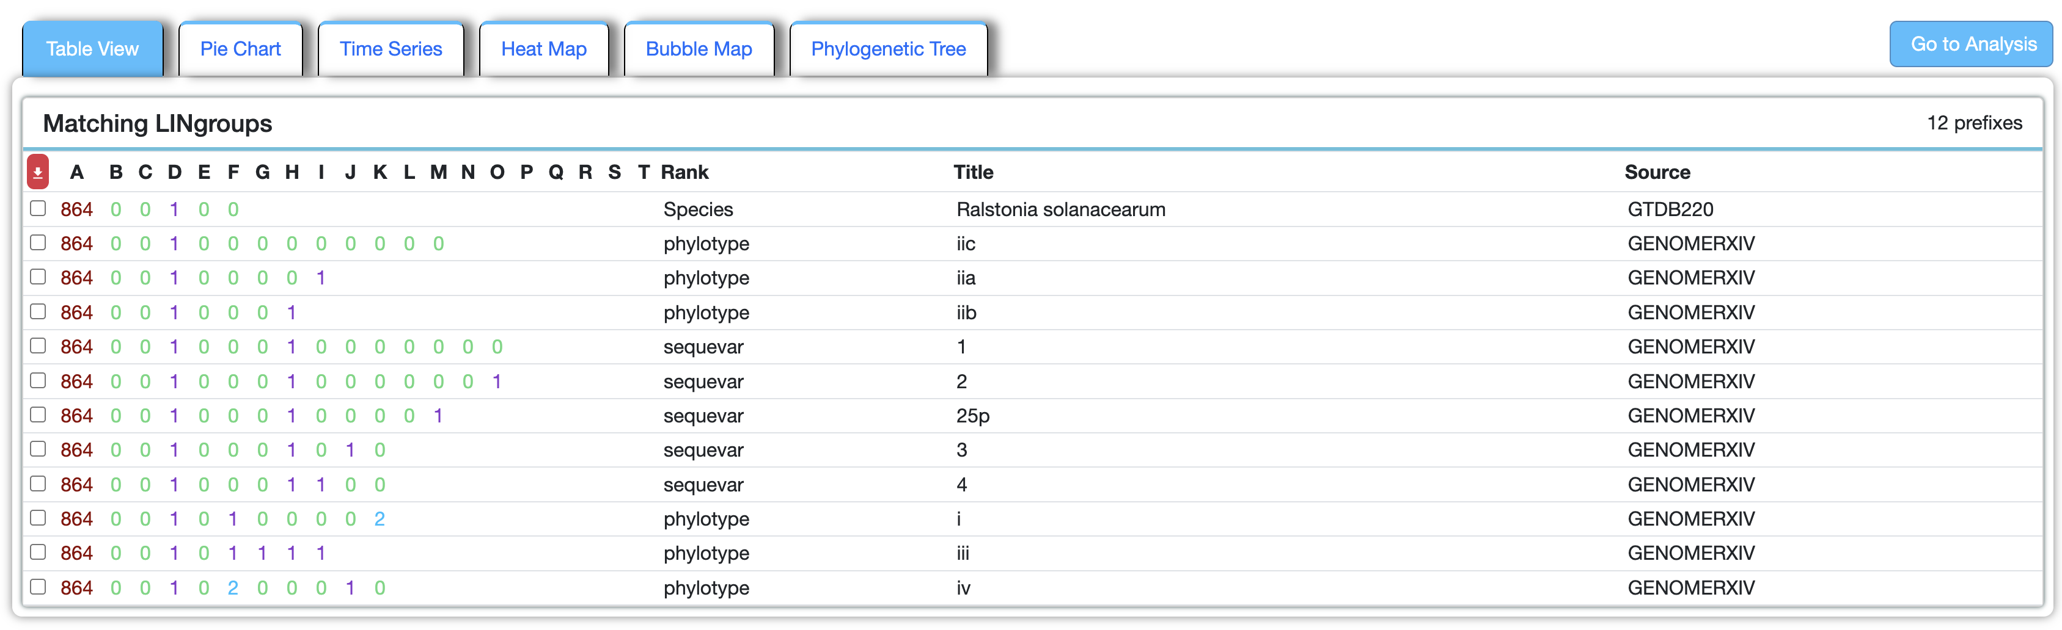
Select Agent
Extending ANI from the species to the strain:
Any monophyletic group can be circumscribed
Any genome can be identified as member of any circumscribed group

Slide 15

LINs are similar to GPS coordinates
LINs can “identify” a precise location (genome) without using any names of any continent, country, state, county, town (phylum, order, family, genus, species) and are much more precise than any “traditional” geography (also providing precise distance).
LINs can provide a stable reference framework to which to ”pin” the borders of countries, states, counties (family, genus, species).
LINs themselves do not change when a country or town (family or genus or species) changes borders or name.
As long as I have the GPS coordinates of a location (the LIN of a genome), I can use different languages or names (taxonomies) for the same location (genome) without getting confused.

Slide 16
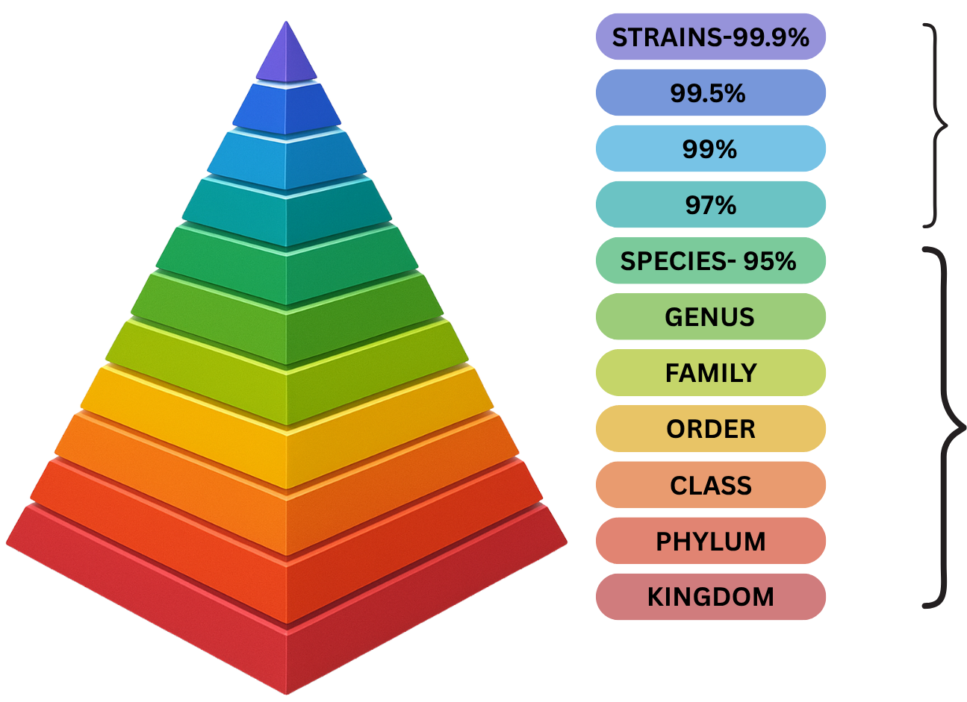
“Enhanced” taxonomy
(LINs)
Traditional taxonomy

